Slide 1
Seat Reservation System
Team 08:
Aangi Seth
Anamika
Megha shree
Sinchana babu kual
Ruba naaz

Slide 2
INTRODUCTION
The main goal behind this project is to provide a user-friendly and efficient system for
seat reservation. It enables users to select and reserve seats based on availability in
various scenarios, such as transport systems, theaters, or events. The tool simplifies the
process by offering an interactive interface to choose the desired seat and confirm the
booking. It ensures accurate tracking of reservations and prevents double bookings,
making it a practical solution for both users and organizers. This system is especially
beneficial for managing seating arrangements seamlessly in real time.

Slide 3
PROGRAM FLOW
Start Program
1.total seats and seat status array.
2.Display menu options:
1.View Seats
2.Book a Seat
3.Cancel a Seat
4.Exit
3.Based on user choice:
Display seat status.
Book or cancel a seat.
Exit the program.
4.Loop back to menu until user exits

Slide 4
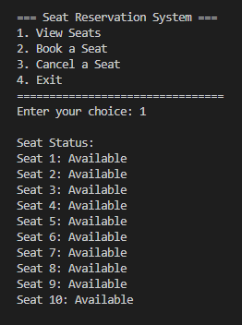
PROGRAM EXPLANATION 1
Initialization
Purpose: The system is designed to handle seat reservation operations with simple
logic and structure.
Variables:
totalSeats: Defines the number of seats available in the system (10 in this case).seats[10]: Maintains the booking status of each seat using an array.
[ ] = Available
[x] = Booked
Choice Handling: A while loop ensures the menu keeps displaying until the user opts
to exit.
User-Friendly Menu: Options are clearly defined for actions:
View Seats
Book a Seat
Cancel a Seat
Exit

Slide 5
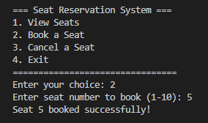
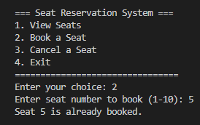
PROGRAM EXPLANATION 2
Book Seat
Function: bookSeat()
Purpose: Books a seat if it is available.
Steps:
Input Validation: The user inputs a seat number to book. If the seat is already booked or the number is invalid, the system shows an error.
Seat Availability Check:
If the seat is available (seats[seatNumber - 1] == 0), it is marked as booked (seats[seatNumber - 1] = 1).
If the seat is already booked, a message informs the user.
Output: Displays success or failure messages based on the seat status.

Slide 6
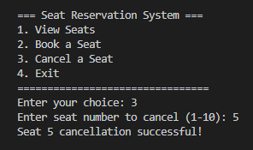
PROGRAM EXPLANATION 3
Cancel Seat
Function: cancelSeat()
Purpose: Cancels a booking for a previously booked seat.
Steps:
Input Validation: The user is prompted to enter the seat number they wish to cancel. Invalid numbers or unbooked seats are flagged.
Seat Cancellation:
If the seat is booked (seats[seatNumber - 1] == 1), it is marked as available (seats[seatNumber - 1] = 0).
If the seat is not booked, an error message is shown.
Output: Displays success or failure messages after cancellation attempt.

Slide 7
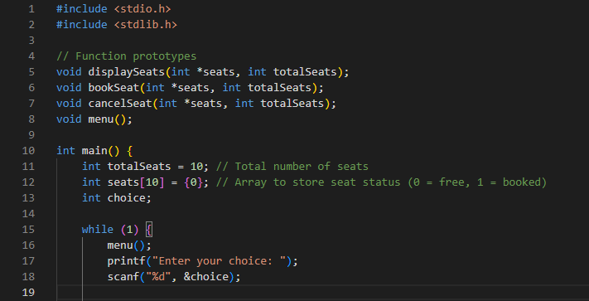
FULL PROGRAM

Slide 8
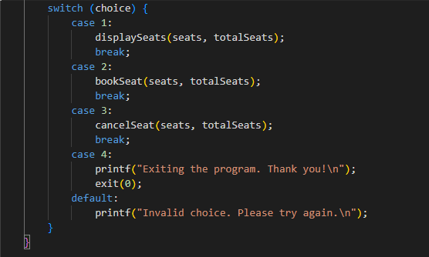

Slide 9
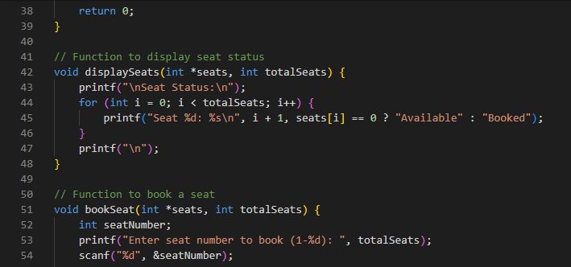

Slide 10
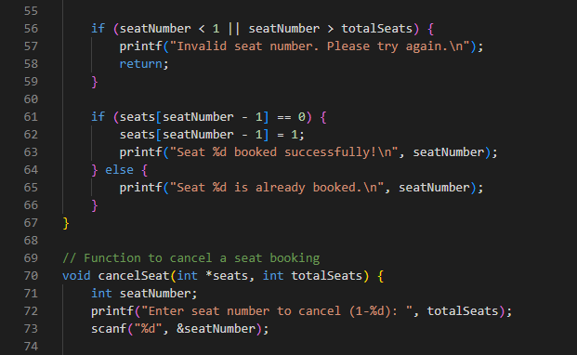

Slide 11
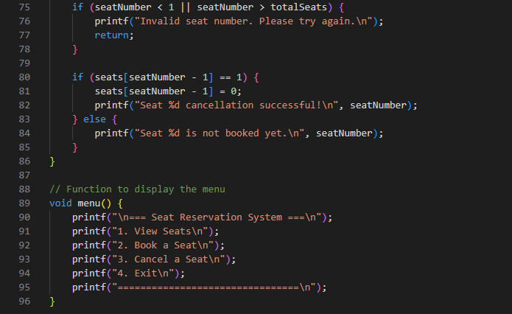

Slide 12
Thank you

